Slide 1

Management Effects on Near-Surface Soil Hydrologic Properties
E. Britt Moore
Ph.D. Candidate- Soil Science, Sustainable Agriculture

Slide 2
Soil Ecosystem Services
Soil performs invaluable ecosystem services:
Climate Regulation
-holds 3x as much Carbon as the atmosphere
-holds more Water than all of the rivers, wetlands, atmosphere combined
Wildlife Habitat
Provision of Food
Water Cycling & Storage
Notes:
Soil C pool 3x as much as atmospheric (approx. 1,500 Gtons), implications for global C cycling and climate change

Slide 3
Soil & Water: Our Most Precious Resources
Soil & Water are inextricably linked…
Freshwater is scarce globally, and availability is highly variable
-Approximately 2.5% of Earth’s water is freshwater
-2/3 of all freshwater is frozen, leaving
less than 1% of Earth’s water readily available for human use
The amount of soil-water is greater than the amount of water in the atmosphere, rivers, and wetlands combined!

Slide 4
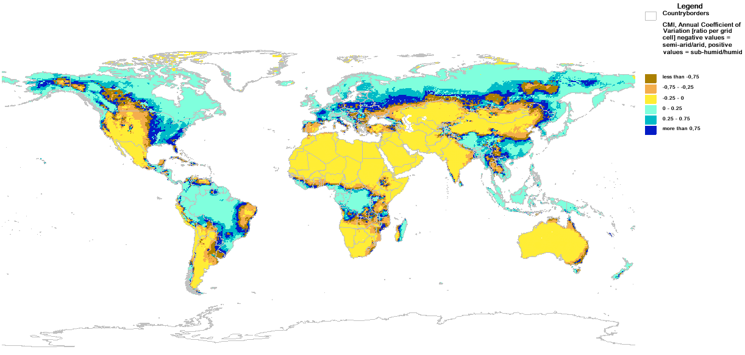
Coefficient of Variation for Climate Moisture Index
The Coefficient of Variation (CV) is a statistical measure of the potential seasonal and inter-annual fluctuations in water availability for regions.
GWSP Digital Water Atlas
http://wiki.gwsp.org/joom/index.php?option=com_content&task=blogcategory&id=34&Itemid=63
Notes:
CV-CMI- Measure of fluctuation in water availability… dark blue & teal indicates higher variability
Iowa experiences high seasonal/ inter-annual fluctuations…what are the implications for extreme precipitation and field runoff?

Slide 5
2012
Drought
2010
Flood
1974
Drought
1977
Drought
1983
Drought
1993 Flood
1988 Drought
Corn
USDA Agricultural Statistics Service
http://quickstats.nass.usda.gov
Notes:
Linear growth in crop yield, which is what we expect
However, dramatic yield losses from the mean correspond with flood and drought events
Environmental Implications of Extreme Water Events and Drastic Yield Reductions
These variations are expected to increase over time with climate change
Avg. 1985-2015 = 9.25 Mg/Ha
Figure courtesy of David Laird: Personal Communication Apr. 2018

Slide 6
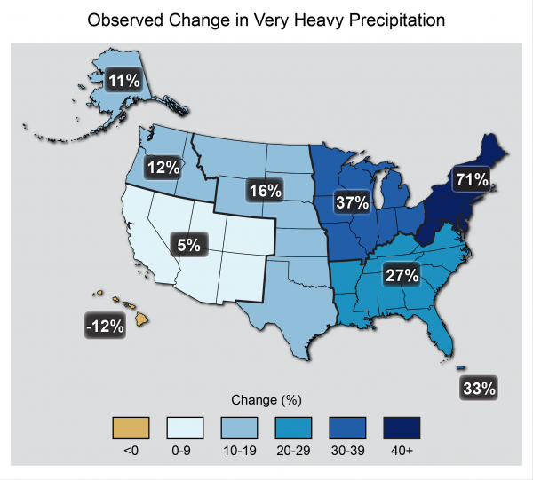
Notes:
Source Report: Climate Change Impacts in the United States: The Third National Climate Assessment
Map shows percent increases in the amount of precipitation falling in very heavy events (defined as the heaviest 1% of all daily events) from 1958 to 2012

Slide 7
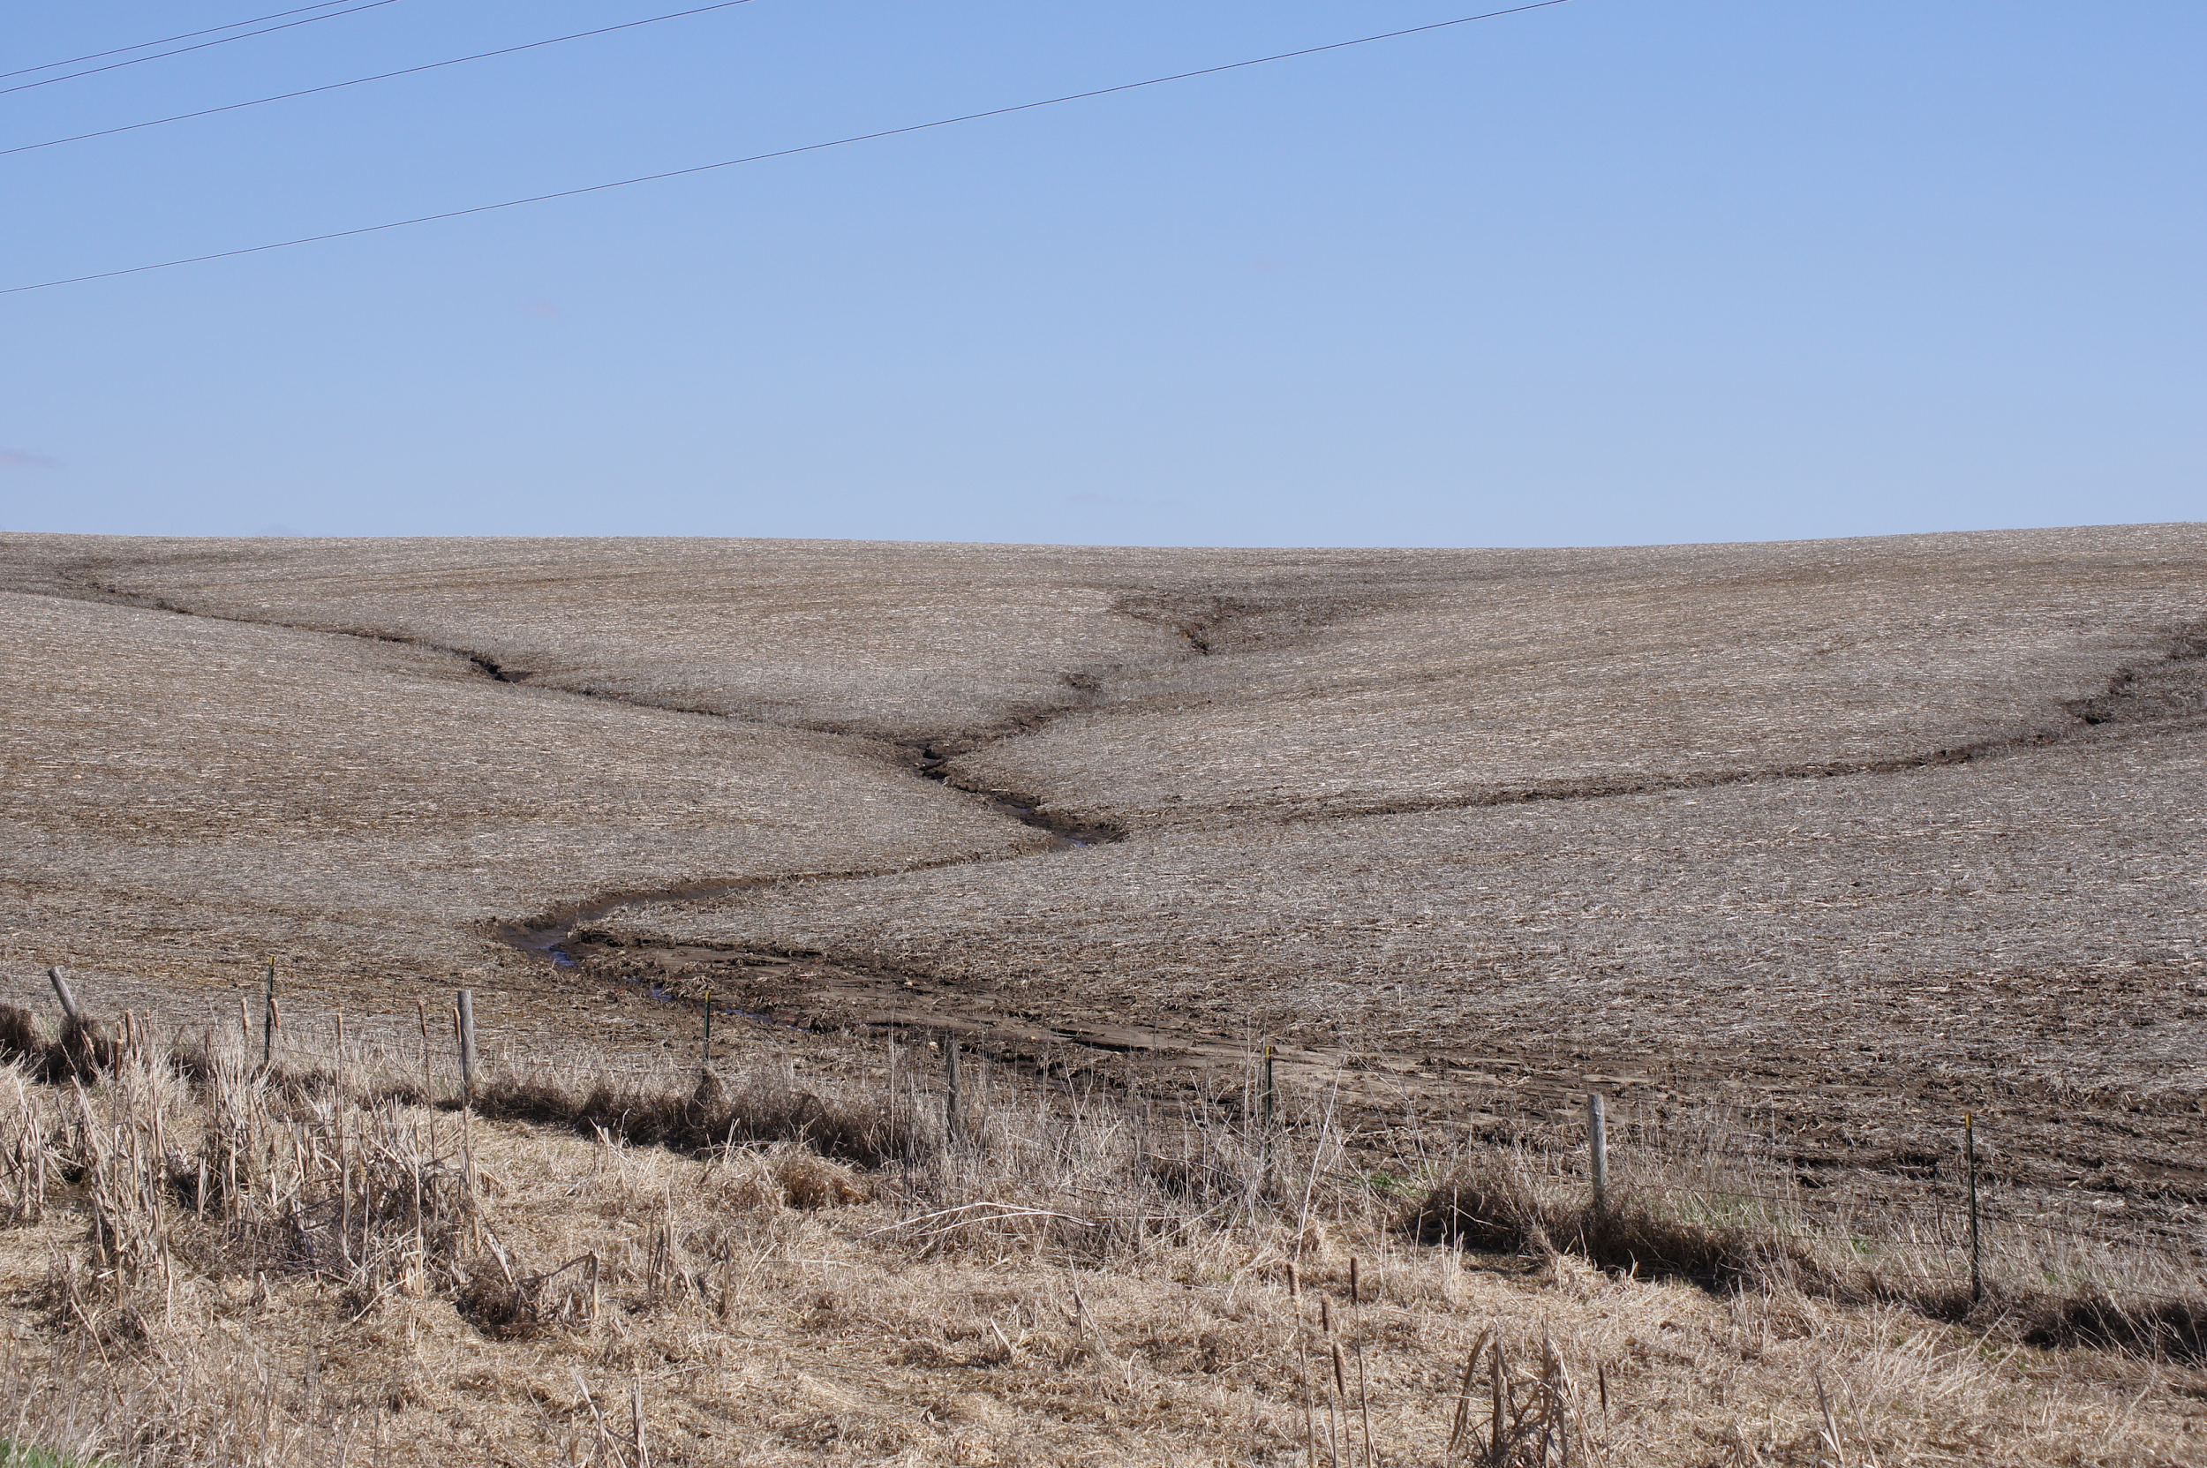
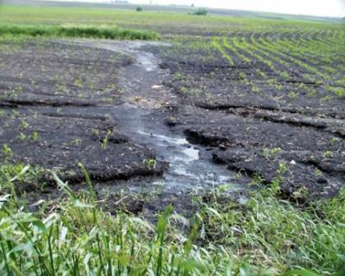
Surface Runoff & Erosion
Average annual rates of soil erosion on
Iowa cropland exceeds 5.8 tons per acre
Surface runoff is a major contributor to soil erosion in the Upper Mississippi River Basin
Notes:
So what are some of the ways that land use affects water…..
Soil Erosion Rates are about an order of magnitude higher than soil renewal rates (half a ton per acre per year)
sediment is biggest in terms of mass for water impairment , soluble P in terms of biological activity impairments
Renewal = 1 inch every 400 years (optimal)

Slide 8
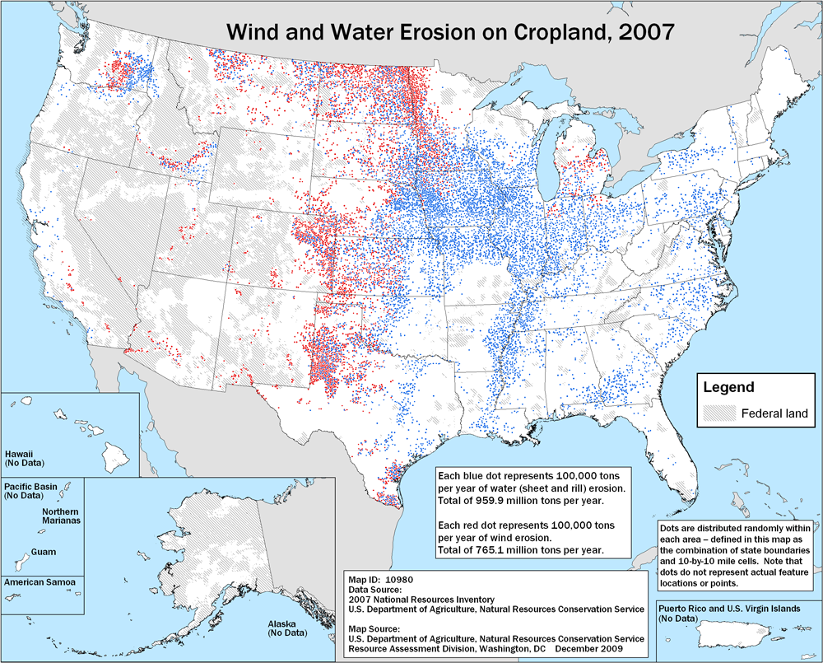
Notes:
Explain colors

Slide 9
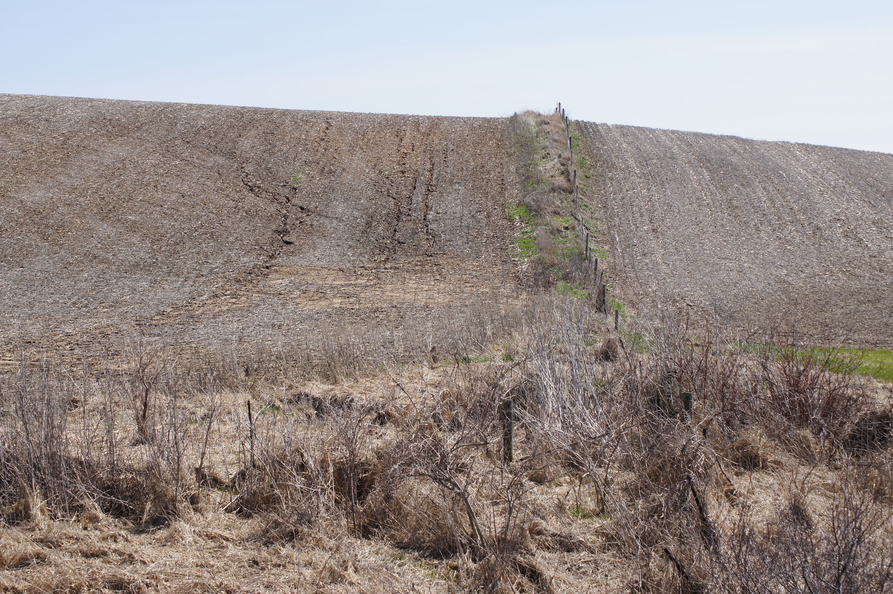
Notes:
Left side of image
Gully formation
Lack of cover & landscape gradient

Slide 10
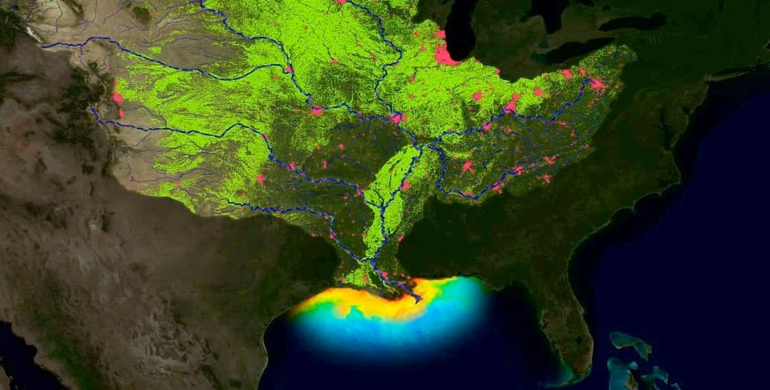
Sediment & Nutrient Pollution Impact Ecosystem Health!
Notes:
More agricultural / row-crop field runoff = greater waterway impairment

Slide 11
Research Hypothesis
Long-term winter cover crop management influences near-surface soil hydrologic properties through altering the soil physical environment and enhancing soil organic carbon.
Notes:
Mention rationale adding labile C
Exploratory research for labile OC, TOC has been established with previous Boyd research.

Slide 12
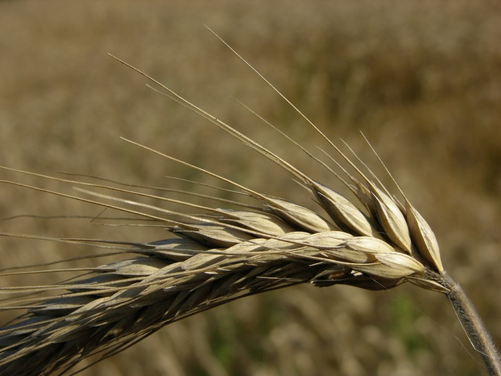
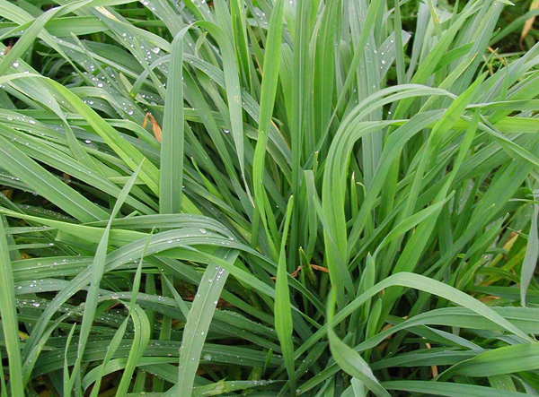
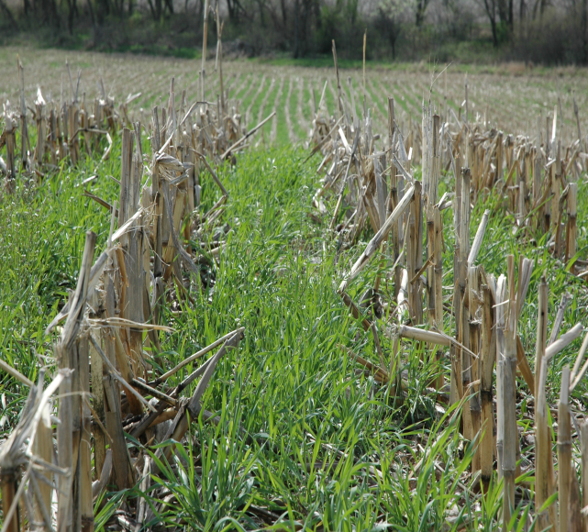
Rye Winter Cover Crops
are easily adapted to conventional crop rotations
reduce soil erosion
reduce nutrient leaching
improve soil health
enhance soil water storage capacity?
Notes:
Images (left to right)
swbiodiversity.org - Secale cereale image
www.cotswoldseeds.com -
Rye (Secale cereale). Ref: JAK. Sowing rate: 75 kg per acre
limecreekwatershed.wordpress.com
Sloan's cover crop in corn stubble

Slide 13
Selected Soil Properties
Bulk Density
Particle Size Distribution
Total Organic Carbon
Permanganate-Oxidizable Carbon
Labile Carbon Mineralization
Pore Size Distribution
Water content at Saturation
Water content at Field Capacity
Water Holding Capacity

Slide 14
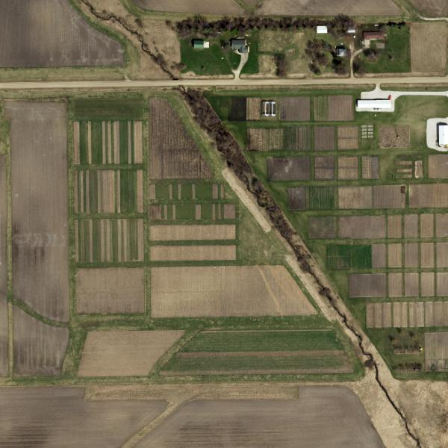
Boyd Research Farm
Boone County, IA
Treatments:
1)Rye CC follow. both corn silage and soybean
2) No Rye (control)
*All plots are no-till
*no-till and cover crops
established in 2001
Boyd Research Farm
Boone County, IA
Treatments:
1)Rye follow. both corn silage and soybean
2) No Rye (control)
Loamy, Mollic Soils
Notes:
No tillage and Rye cover treatments since 2001

Slide 15
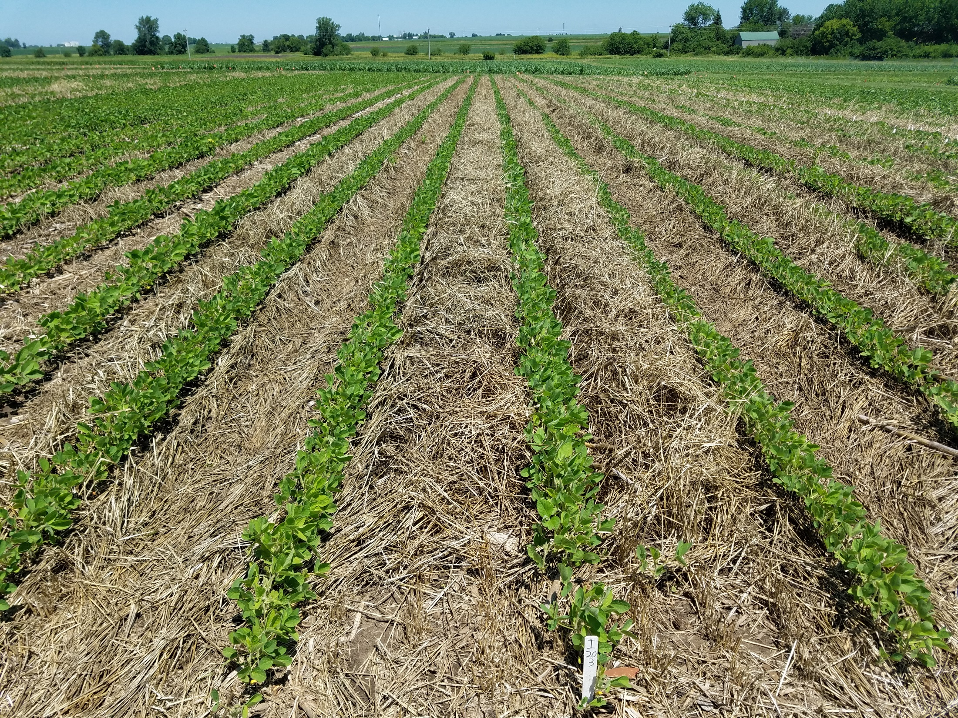
Rye Cover Crop Effects on Soil Quality
SOC & POC were higher in plots with rye cover crop than control
The effects of a rye cover crop were most pronounced in the uppermost layer of the soil profile
There was no negative treatment effect on main crop yield
Moore et al. 2014. Rye cover crop effects on soil quality in no-till corn silage-soybean cropping systems. Soil Sci. Soc. Am. J. 78:968-976

Slide 16
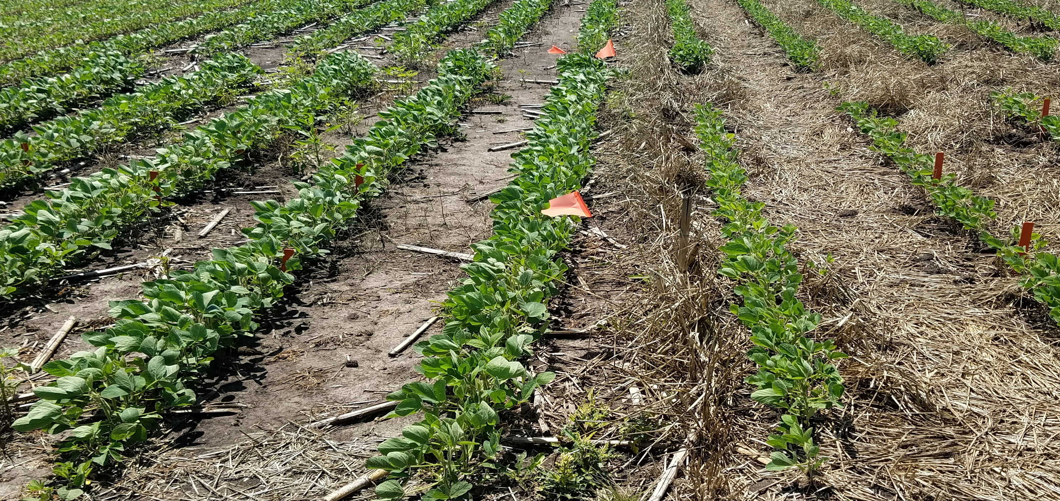

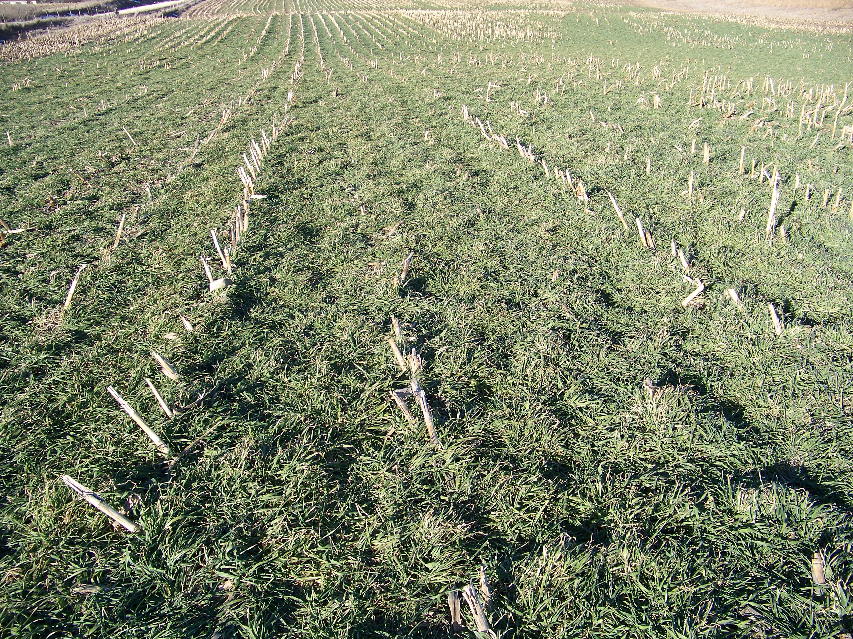

Slide 17
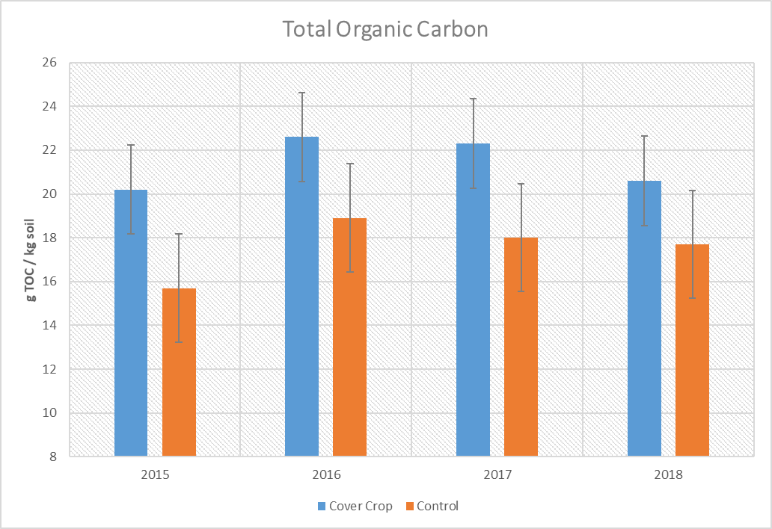

Slide 18
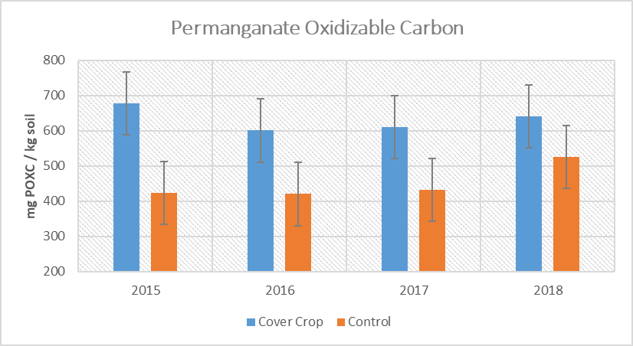
Notes:
Culman et al. 2012 shows usefulness of POXC as a labile carbon indicator

Slide 19
Notes:
May 2018 dry (31 mm below 50-year avg.)
May 2018 also hot (4° above 50-year avg.)
June 2018 one of the wettest months on record (156 mm above 50-year avg.)
Letters for significant

Slide 20
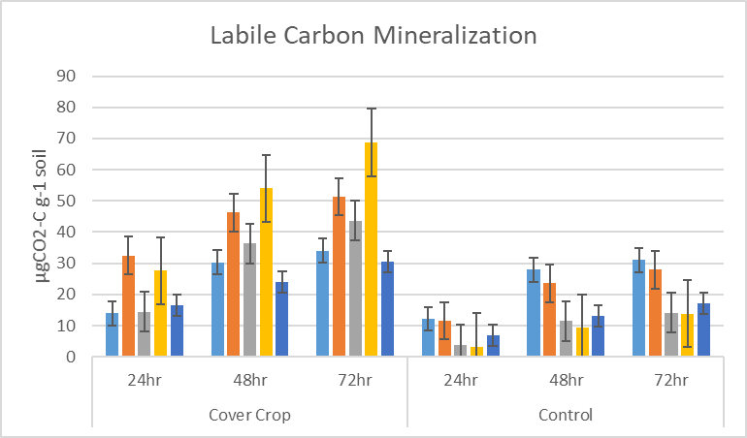
*colors represent field replications
Notes:
Franzluebbers research shows relationship b/w microbe activity and SOC

Slide 21
Soil Water Retention
Water Energy Potential: Ψ_{T} = Ψ_{g} + Ψ_{o} + Ψ_{m}
*Relative to pure water at reference condition
Water Content: Θv = M_{l} / V_{t}
*for H₂O 1g=1cm³=1mL
Soil Water Retention Curve: relationship between Θv & Ψ_{m}
Notes:
Energy Potential- the ability of a given unit quantity to perform work relative to a reference state at elevation, unbound, and without solute or temperature differences
Energy gradients drive mass and energy flux, e.g. … Jw=K*(H/L)… flux density equals conductivity * energy potential gradient
Movement from high to low energy potential

Slide 22
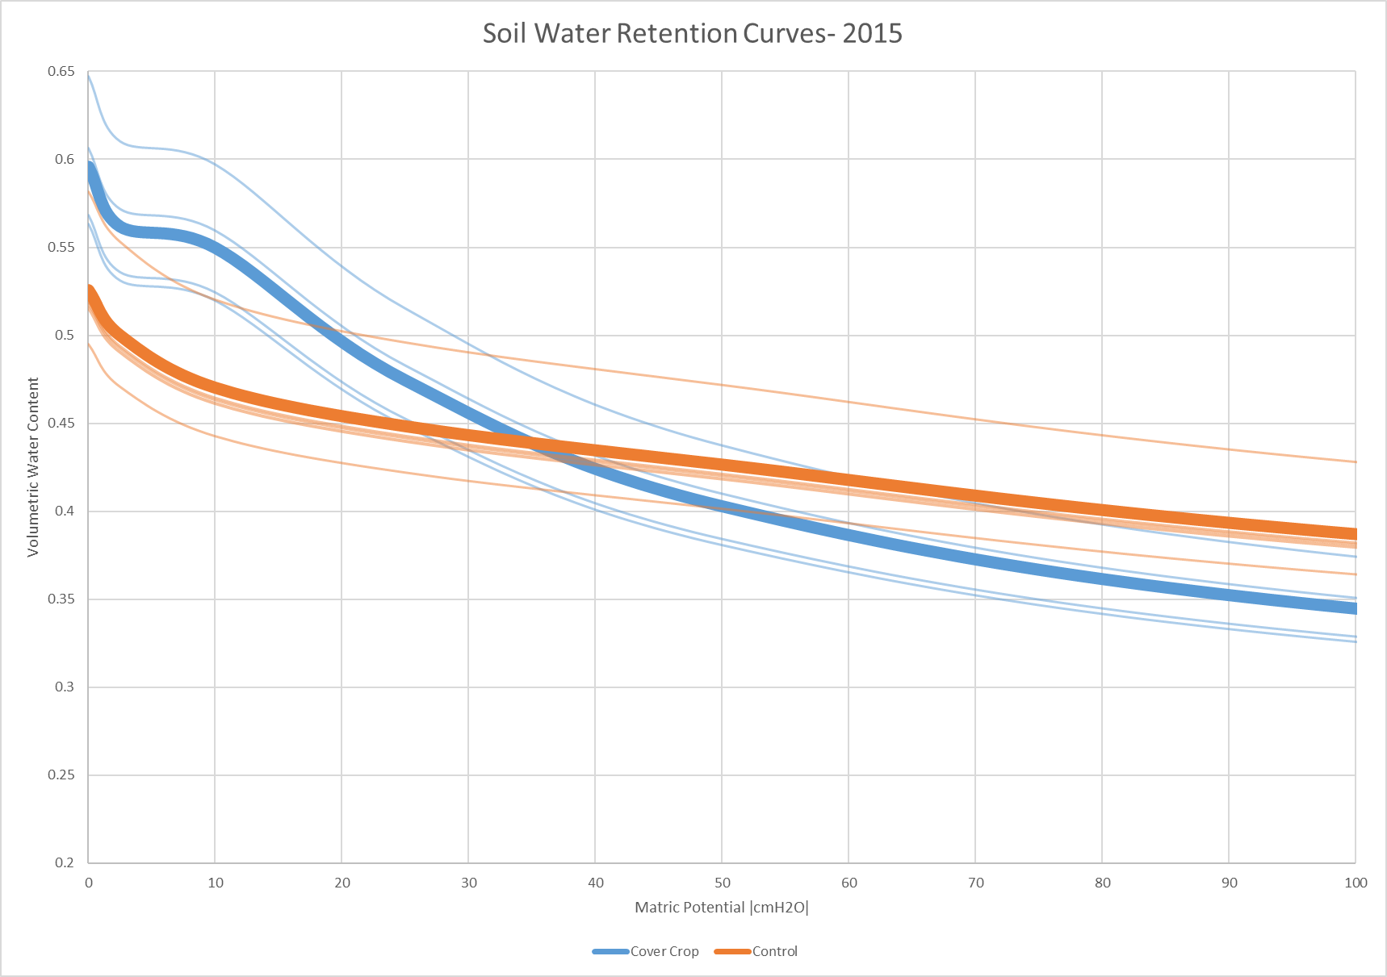

Slide 23

Saturation
Field Capacity

Slide 24
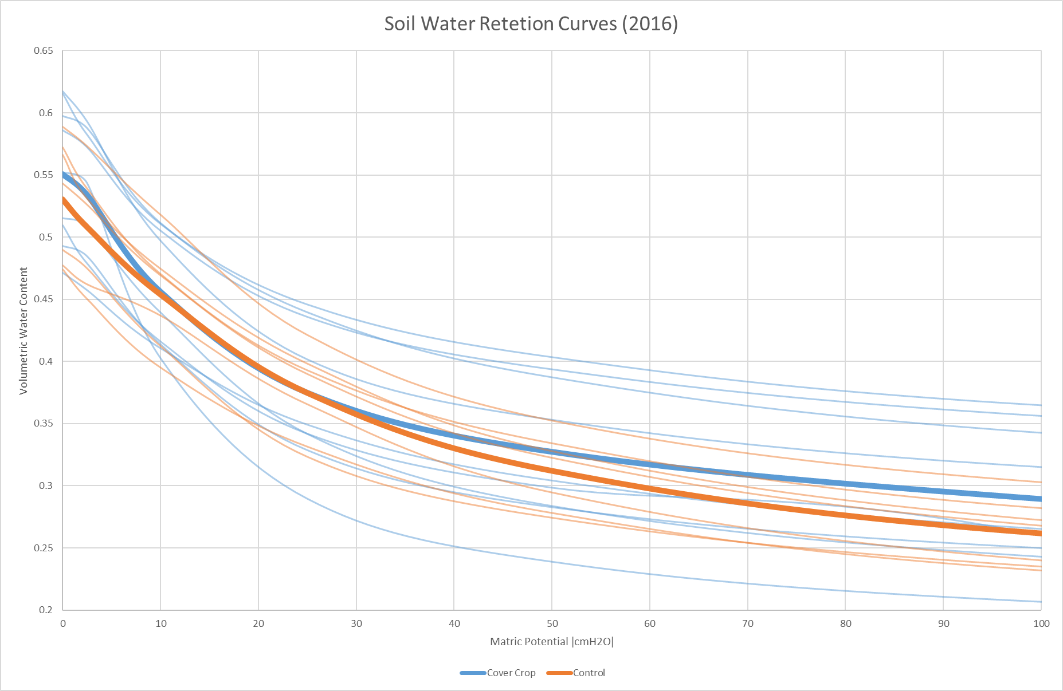

Slide 25
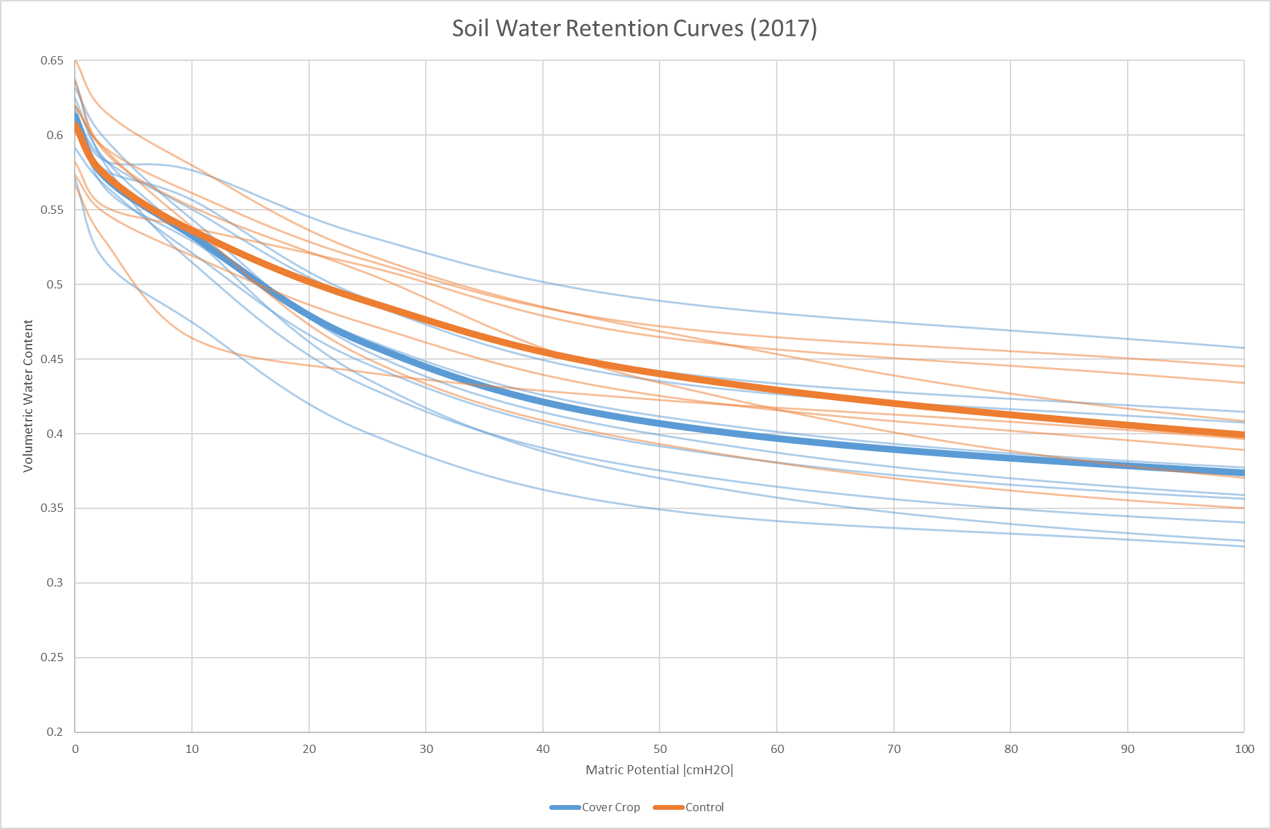

Slide 26
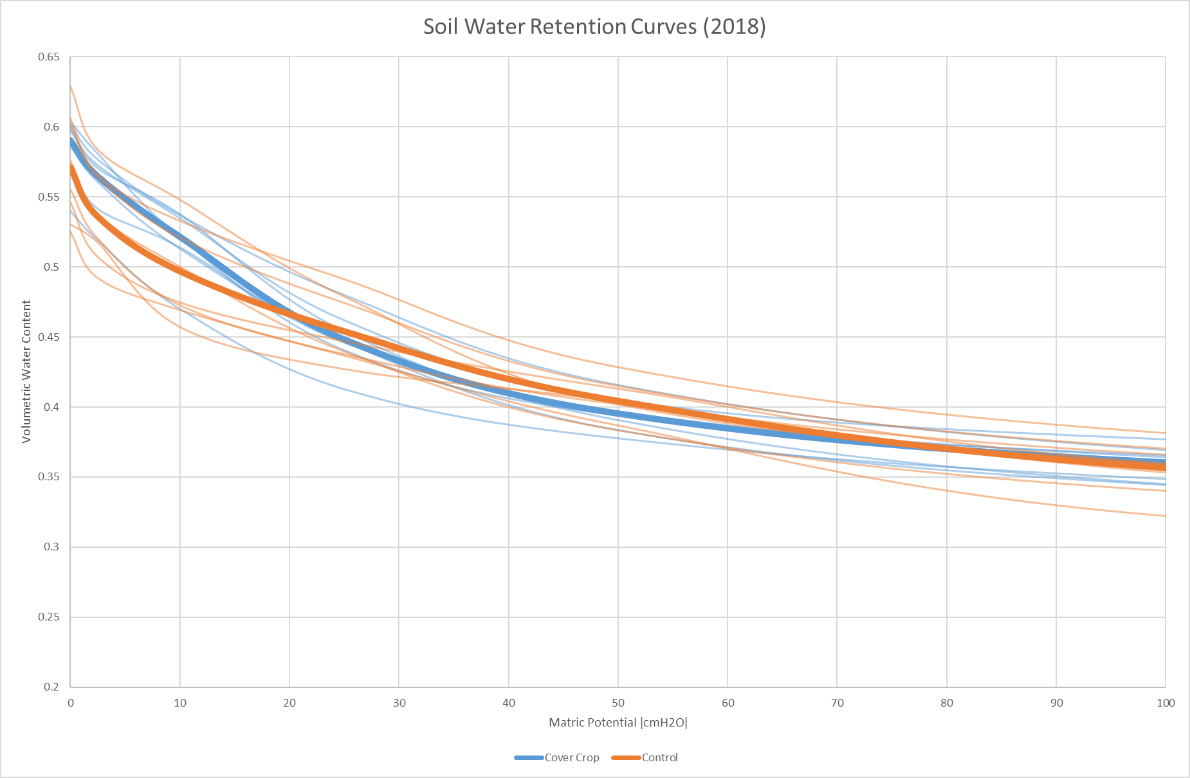

Slide 27
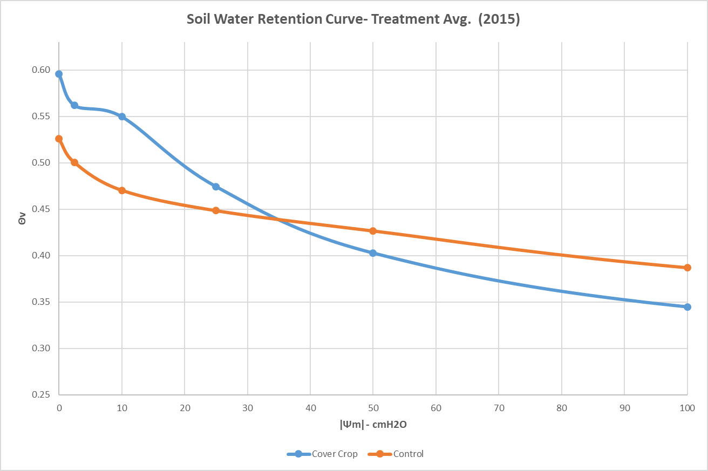
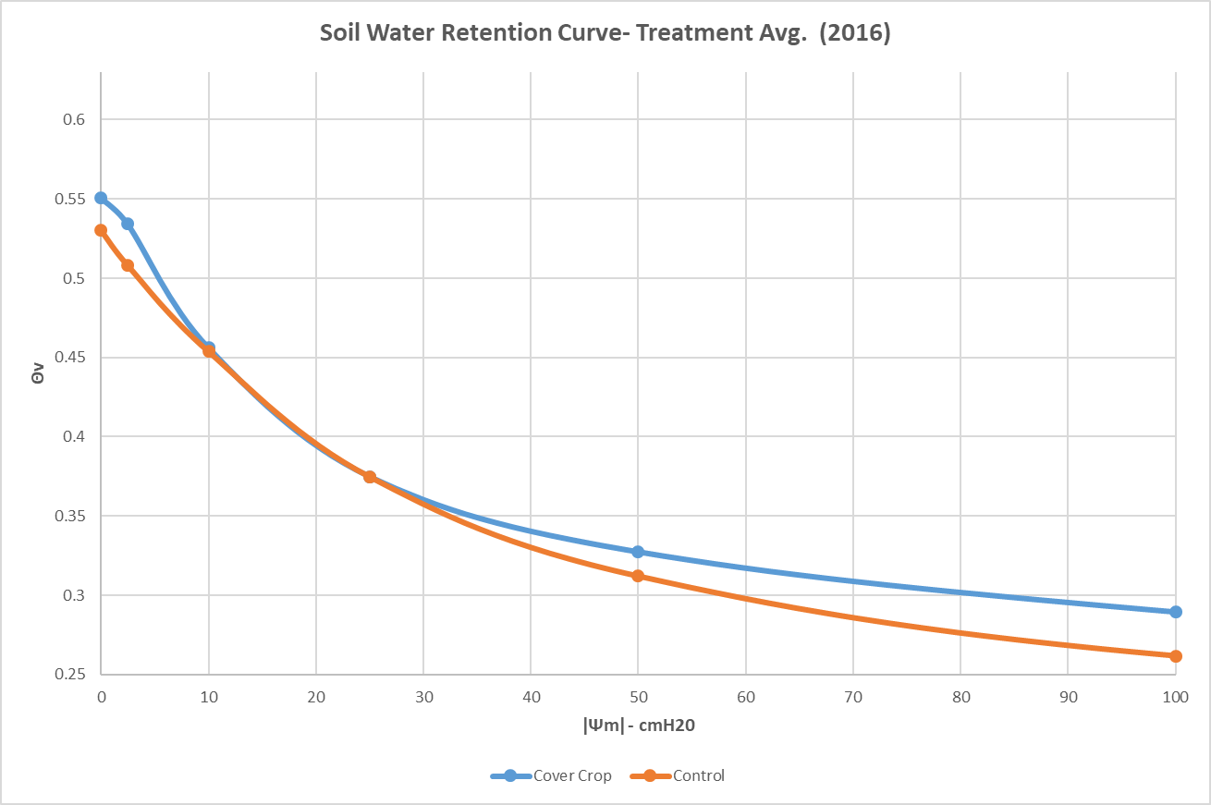
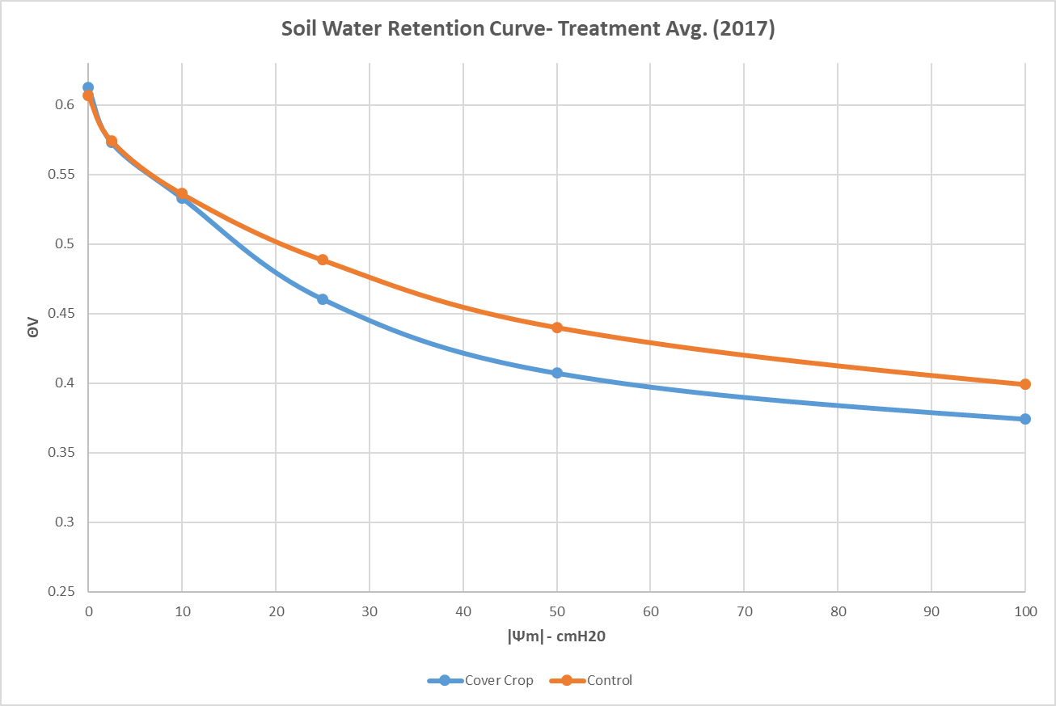
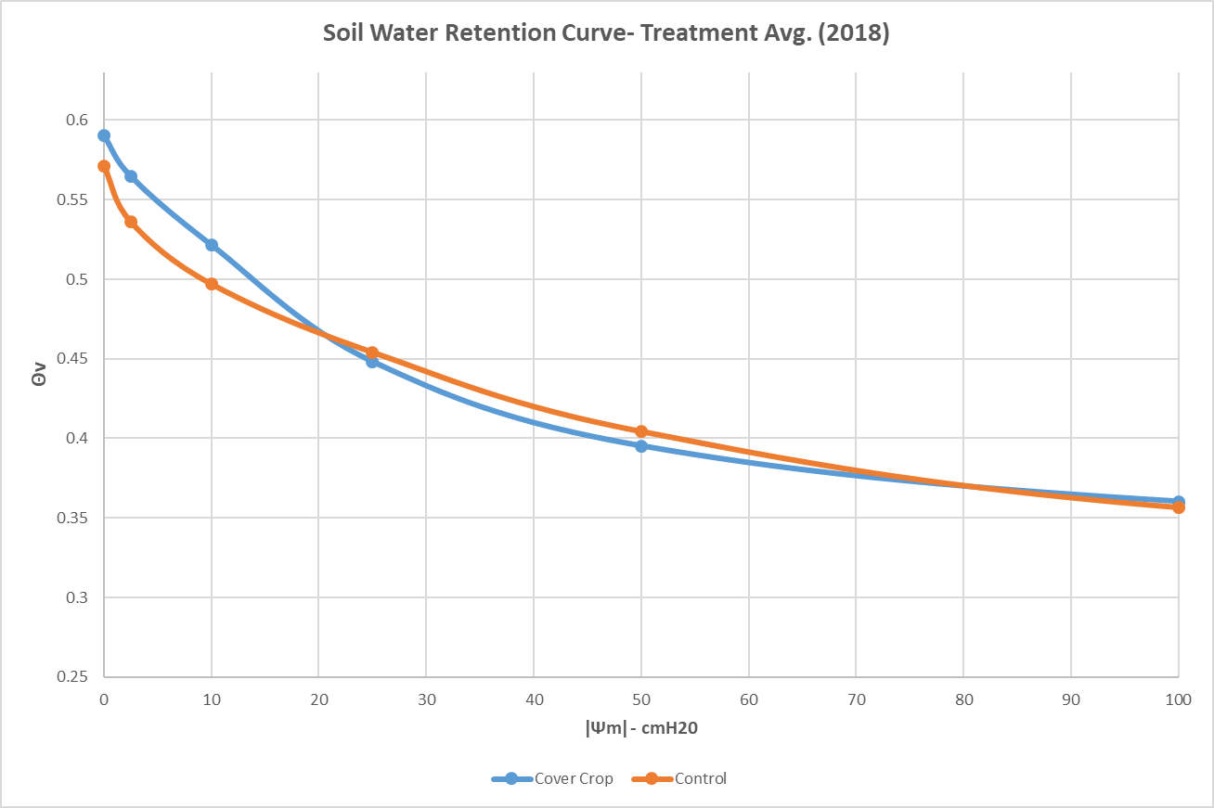
Notes:
Avg. Curve Values

Slide 28
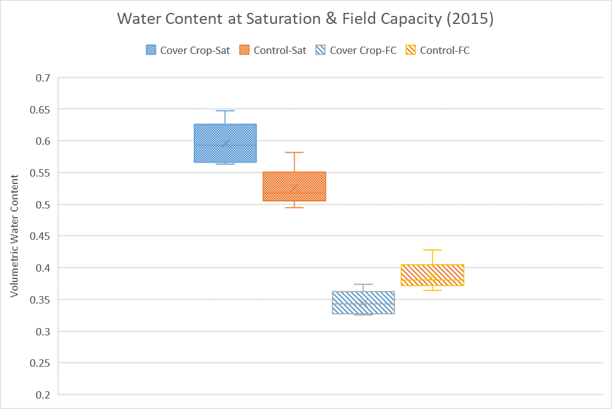
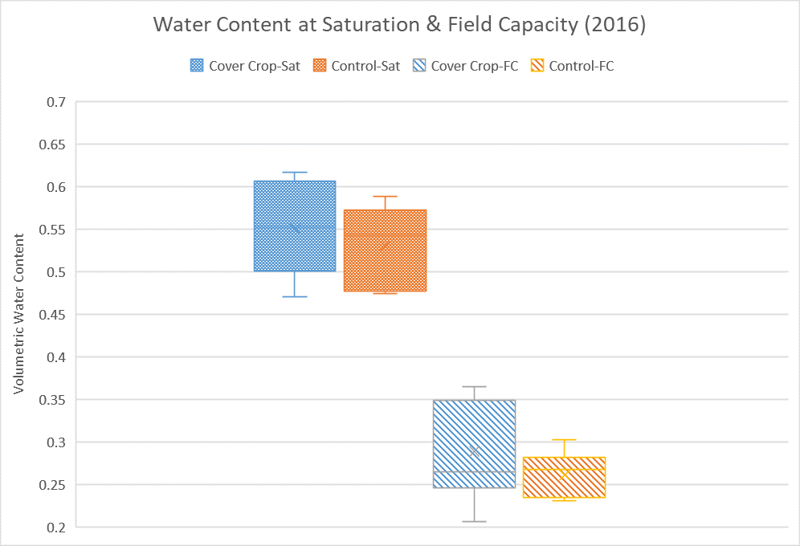
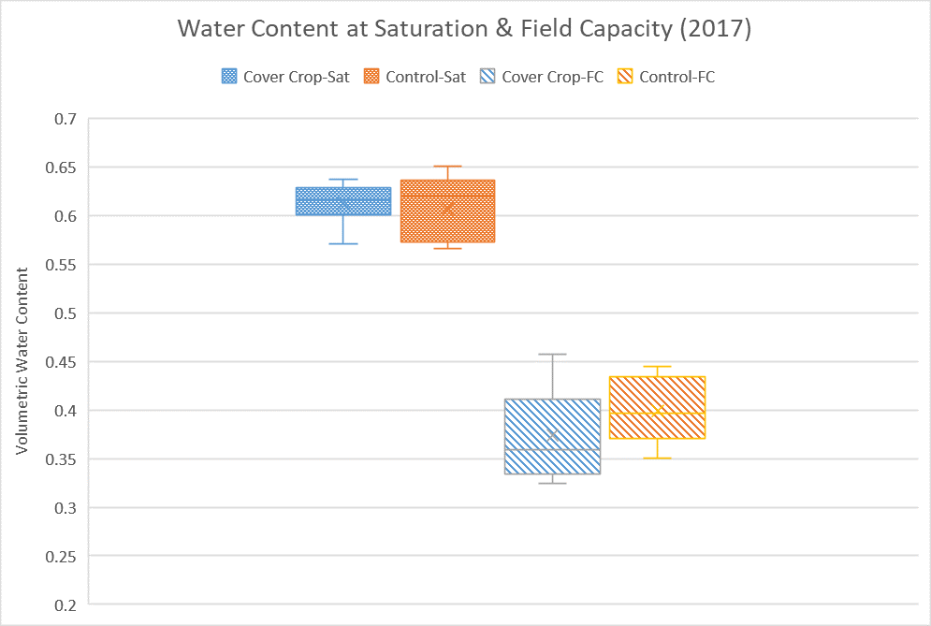
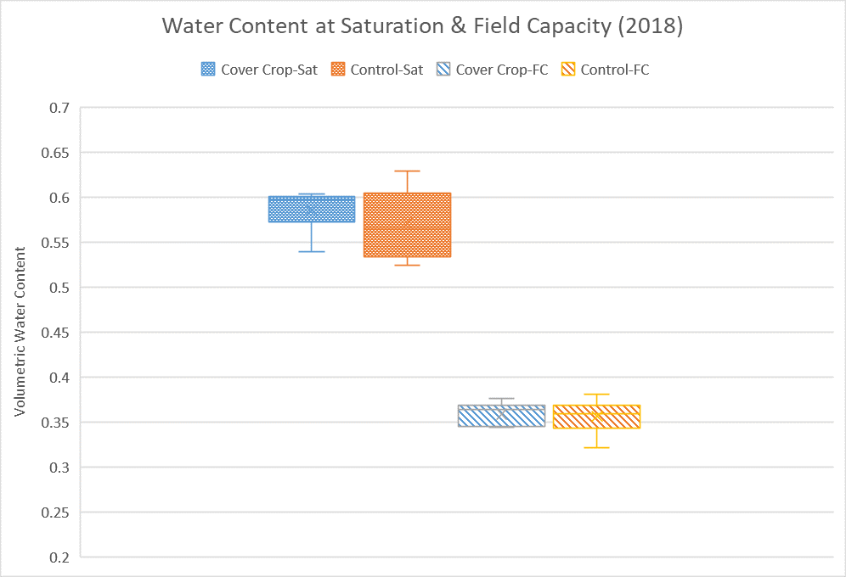

Slide 29
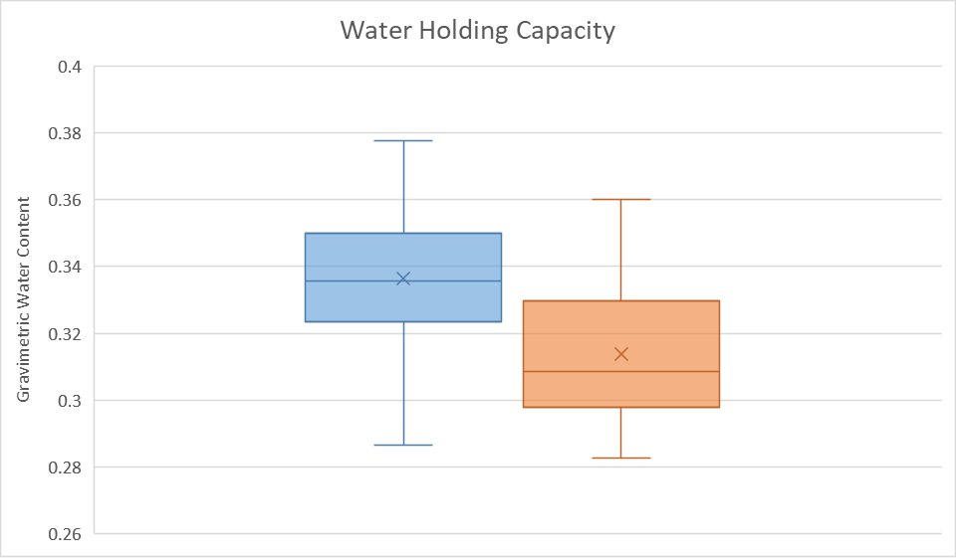

Notes:
>30um macropore
<30 micropore

Slide 30
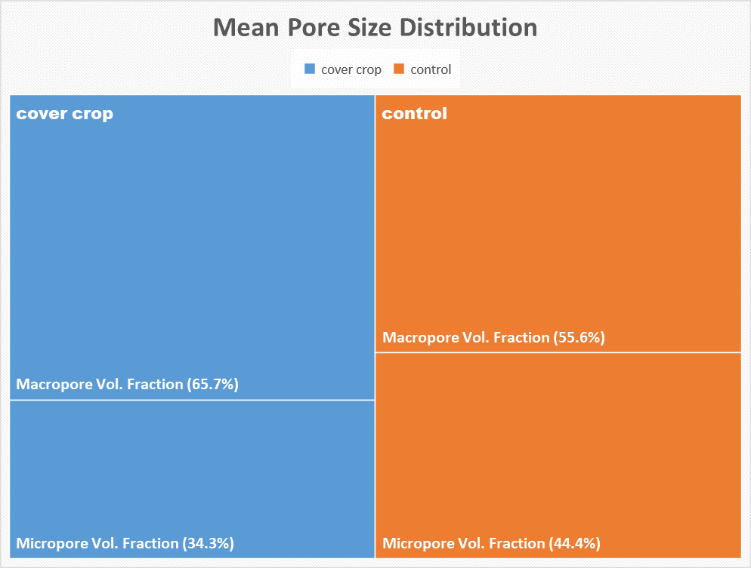
Notes:
>30um macropore
<30 micropore

Slide 31
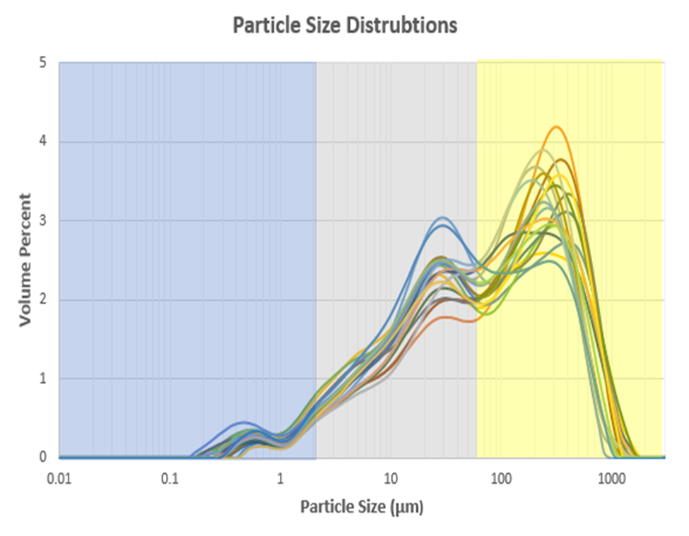
*No Significant Differences in Texture or Bulk Density

Slide 32
Long-Term Rye Cover Crop Effects on Soil Hydrology
Rye cover crops increase volumetric water content at saturation by 2.5%, on average
An increase in water storage capacity of 12.5 T/ha⁻¹
(1336 gallons per acre) in the top 5-cm soil layer
Given the average Iowa farm size is 359 acres, surface runoff reduction per farm ≈ 479,600 gallons
Notes:
3300 gallon per hectare in top 5 cm = 12.5 metric tons
1 hectare = 2.47 acres

Slide 33
Long-Term Rye Cover Crop Effects on Soil Hydrology
Rye cover crops increase water holding capacity by 3.4%, on average
An increase in water retention at field capacity of 17 T/ha⁻¹
(1817 gallons per acre) in the top 5-cm soil layer
Given the average Iowa farm size is 359 acres, water retention per farm ≈ 652,300 gallons
Notes:
Average bulk density is 1.32 g/cm3
Gravimetric water content was increased 2.6%
4490 gallon per hectare in top 5 cm = 17 metric tons
1 hectare = 2.47 acres
Water holding capacity is the total measure of a soil’s water retention at field capacity (FC), while field capacity is a characteristic that describes the matric pressure and water content at which gravity-driven drainage of a previously saturated soil has become negligible.
The period between wetting and negligible drainage under field conditions is usually 48-72 hours.
Matric pressure values at FC generally range from -50 to -330 cmH2O. Although -330 cmH2O is a widely used generalization, FC can vary substantially across soils as it is dependent on water table depth.

Slide 34
In Summary…
Rye cover crops enhance soil water storage capacity.
Rye cover crops increase total & labile organic carbon.
Although rye cover crops enhanced SOC, there was little correlation between enhanced SOC and increased water retention.
Notes:
Soybean over time
Cover is same 50-500
Control is lower 10-500
Silage over time
Cover is same for 50-200
Control higher in Silage over time for 10-200

Slide 35
Research Implications
Long-Term winter cover crop management enhances:
~macropore vol. fraction
~water holding capacity
~total & labile organic carbon
Possible implications for enhanced plant available water (further research is needed!!!)
Extreme precipitation event impact mitigation
Development of improved regional flood mitigation practices

Slide 36
Acknowledgments & Gratitude
Major Professors & Distinguished Committee Members:
Tom Sauer
Rick Cruse
Lee Burras
Robert Horton
Tom Isenhart
ISU Agronomy Department:
Kendall Lamkey
Marshall McDaniel
National Lab. for Ag. & Environment (NLAE):
Jerry Hatfield (retired)
Keith Kohler (retired)
ISU Graduate College:
Thelma Harding

Slide 37
Acknowledgments & Gratitude
This research was made possible through generous contributions by:
The Alliance for Graduate Education and the Professoriate (AGEP)
The Graduate Minority Assistantship Program (GMAP)
Ruppert and Judith Hunziker Graduate Scholarship in Soil Sciences
Vernon C. Miller Scholarship in Agronomy
Gary and Ann Holck Graduate Scholarship in Sustainable Agriculture

Slide 38
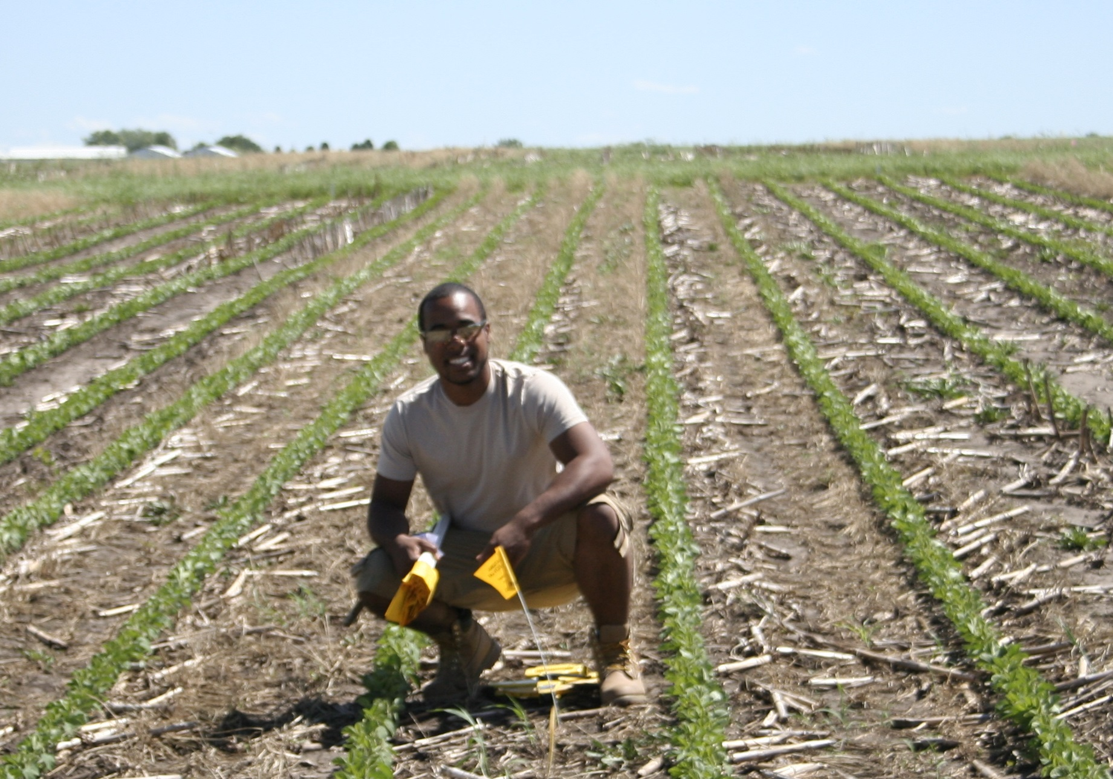

Questions & Comments

Slide 39
Supplemental Data

Slide 40
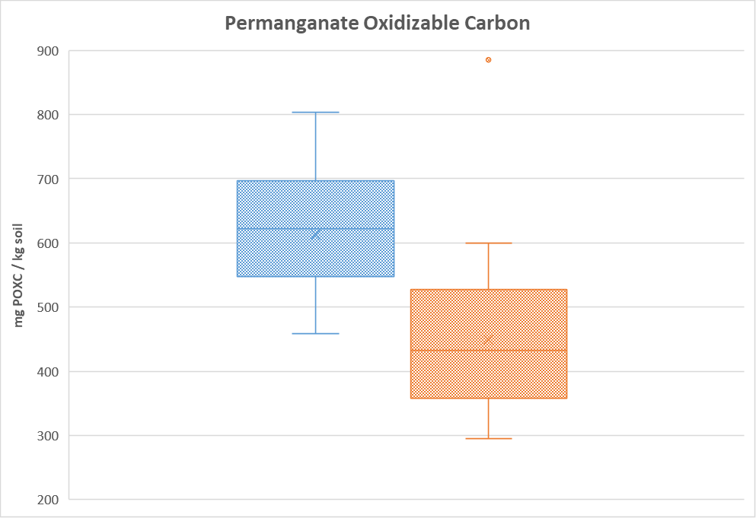

Notes:
Avg. 2015-2018

Slide 41
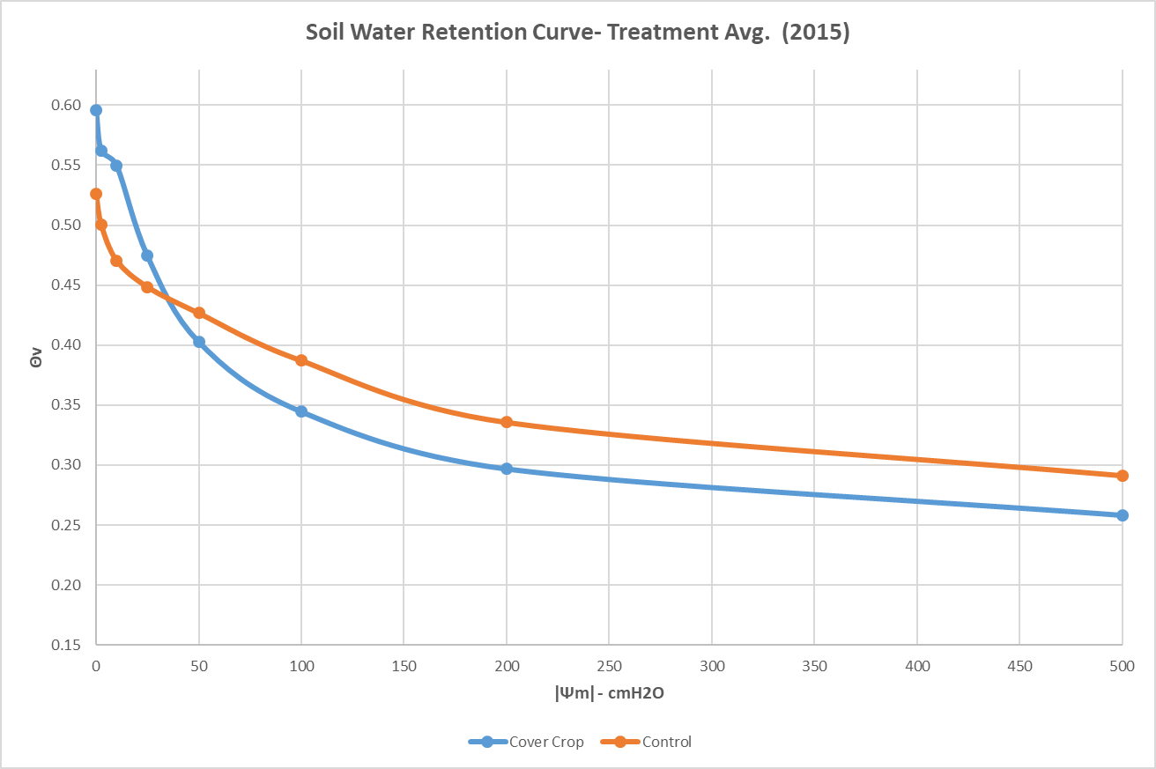

Slide 42
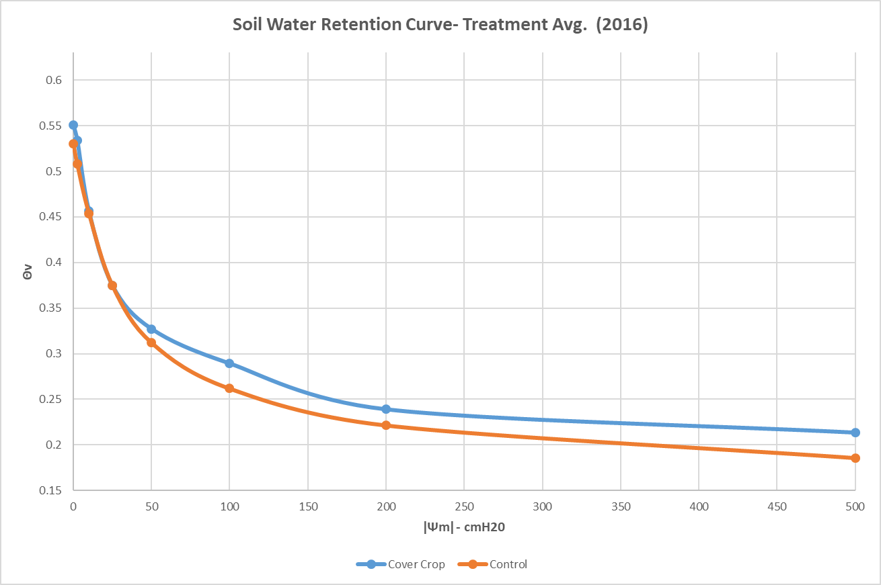

Slide 43
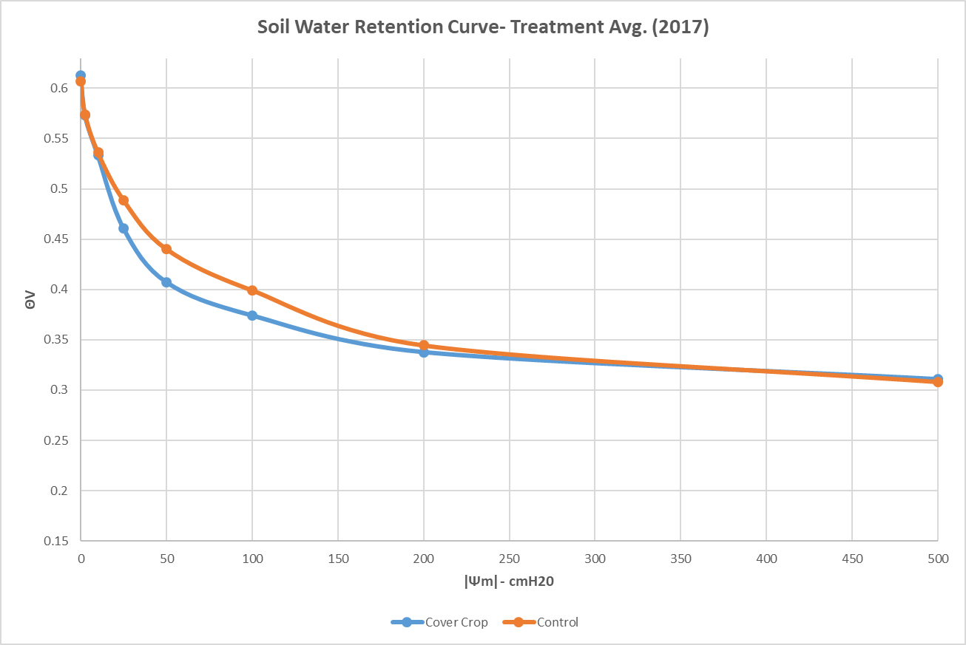

Slide 44
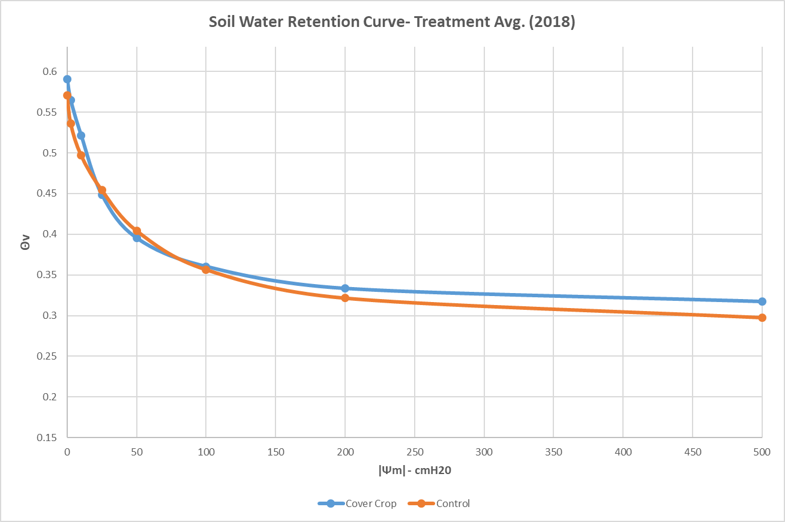

Slide 45
